Slide 1


SAP Full-Stack Developer training
ABAP on HANA, UI5 & Fiori, Analytics with OData
Anubhav Oberoy
Day – 7

Slide 2

Agenda – Day 7
Introduction to OData Services
OData basics
Client Side Query With Odata
Sap odata (v2)
Northwind OData services
Consuming Northwind OData Services from UI5 Application
--Break--
Deployment Options
EPM Data model
ABAP SEGW Class
Creating OData Service
Building GetEntitySet Method

Slide 3

Introduction to OData Services
OData is open data protocol, it is used to create REST based services, initially developed by the OASIS company later acquired by Microsoft and make open source.
REST – Representational State Transfer – also known as STATELESS Communication
OData was developed by Microsoft in 2007 and later they made it open source.
Presentation
Fiori
SAP_UI
http request
response
OData
Software Innovation
Hardware Innovation
Hana
Note: Fiori Only and Only Understand OData.

Slide 4
OData Basic
When we call a service, it loads a service document, a service document includes multiple OData Entity Sets inside. Each service also has a metadata document which explains about properties inside of each entity set.
Service Document (Collection of Entity Sets) – 1 Entity Set = 1 DB Table
https://services.odata.org/V2/(S(gte5obp1xr5gdvcqffzwbrwq))/OData/OData.svc/
Service metadata (/$metadata) – all the entity types and entity sets
Entity Type is the blue print of data set, entity set is the access point of actual data
https://services.odata.org/V2/(S(gte5obp1xr5gdvcqffzwbrwq))/OData/OData.svc/$metadata
Access Multiple Records of an Entity Set (SELECT * FROM dB table)
https://services.odata.org/V2/(S(gte5obp1xr5gdvcqffzwbrwq))/OData/OData.svc/Products?$format=json

Slide 5
Format of an OData URL
http(s)://hostname:port/sap/opu/odata/sap/SERVICENAME_SRV/ENTITYSET?p1=val&p2=val
Protocol
Adress & Port
Path prefix
Service Name
End Point Access Data
Query Options

Slide 6
Client Side Query with OData
Sets the page size of results.
02
$top
Indexes into a result set. Also used by some APIs to implement paging and can be used together with $top to manually page results.
Returns the results in the specified media format.
01
03
$format
$skip
ODATA Query
06
04
Retrieves related resources.
Filters properties (columns).
$expand
$select
05
$filter
Filters results (rows).

Slide 7
SAP OData V2 (Version 2)
OData v2 is a set of new standards which are add-ons to SAP OData V1, and these are as follows:
Client-side sorting and filtering
All requests can be batched
All data is cached in the model
Automatic Message handling
You can read more about SAP OData v2 vs OData v1 here.
Northwind OData service
Northwind is publicly available OData service. You can use this freely available OData service to learn how to use and consume OData service in SAPUI5 applications with SAP WebIDE.
https://services.odata.org/V2/Northwind/Northwind.svc/
More free OData service: https://services.odata.org/

Slide 8
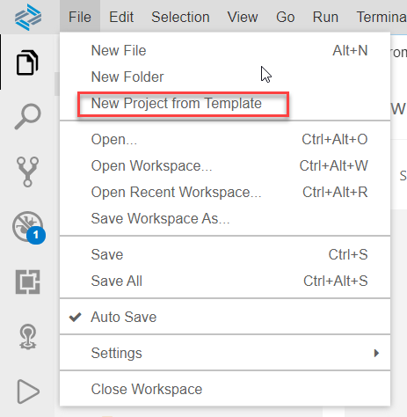
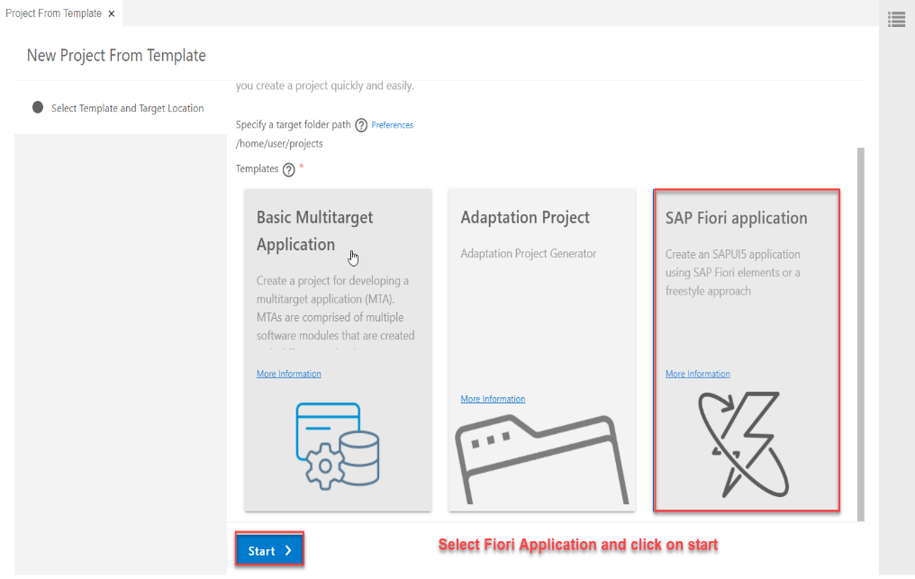
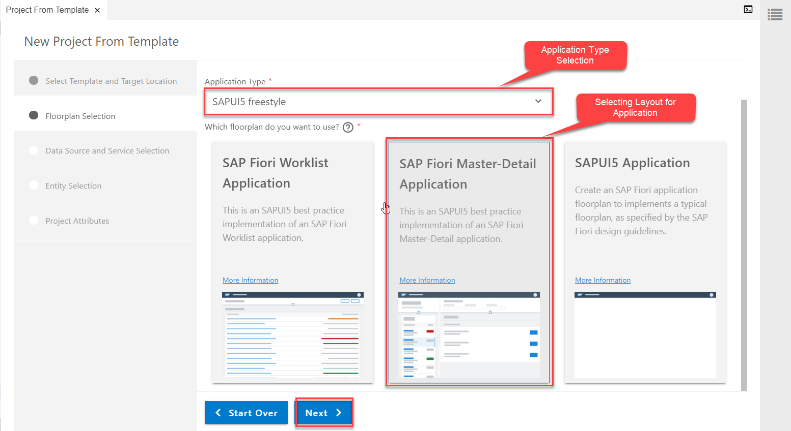
Consuming Northwind OData service
Creating a Fiori Application From Template which Consumes Northwind OData service
Step1: Starting Project from Template
Project From Template
Template Selection (Fiori Application)
Application Type & Layout

Slide 9
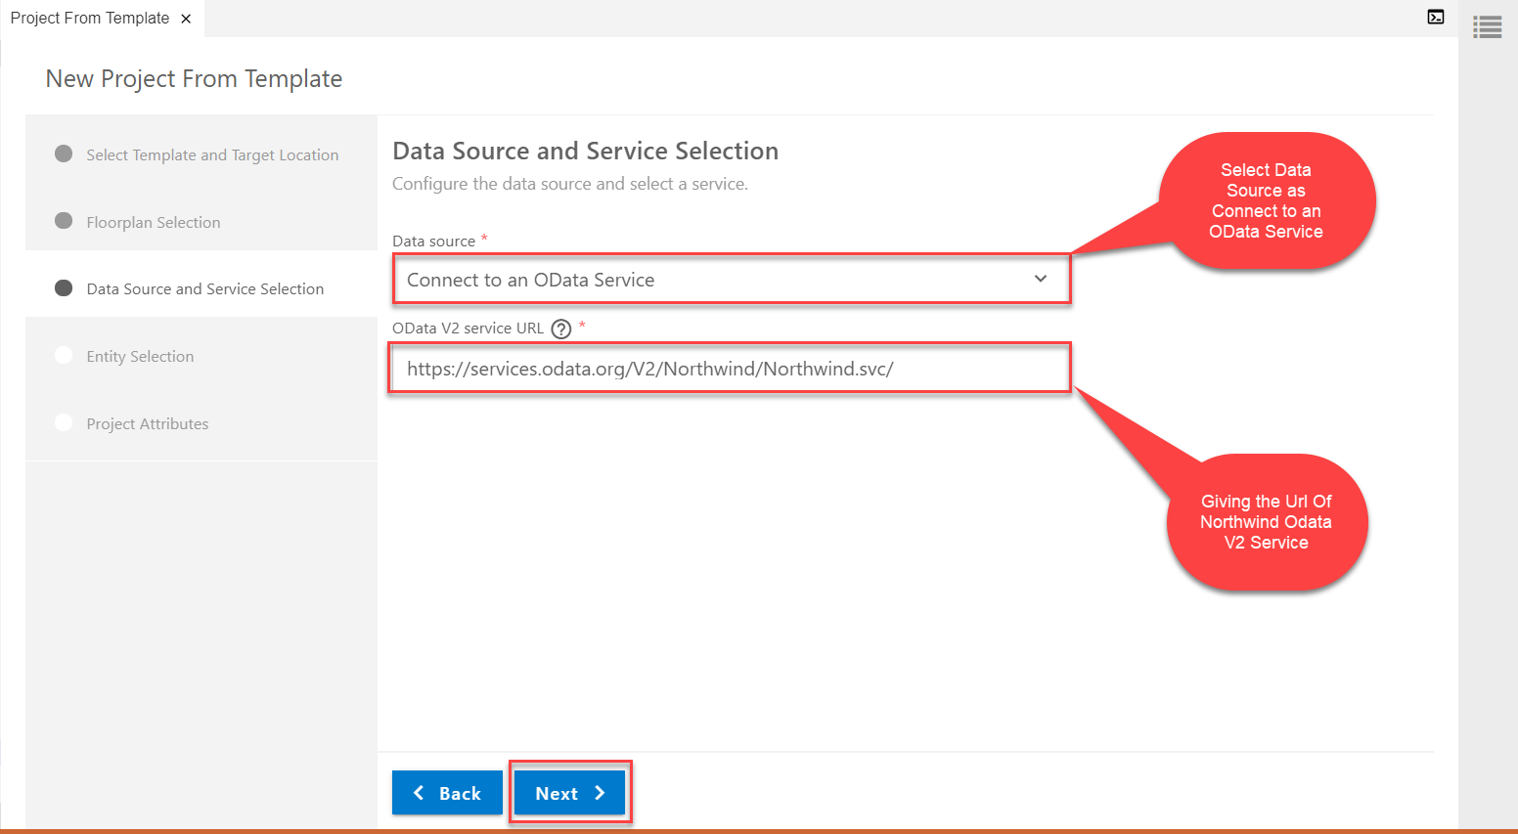
Consuming Northwind OData service
Step2: Data Source and Service Selection
service url: https://services.odata.org/V2/Northwind/Northwind.svc/

Slide 10
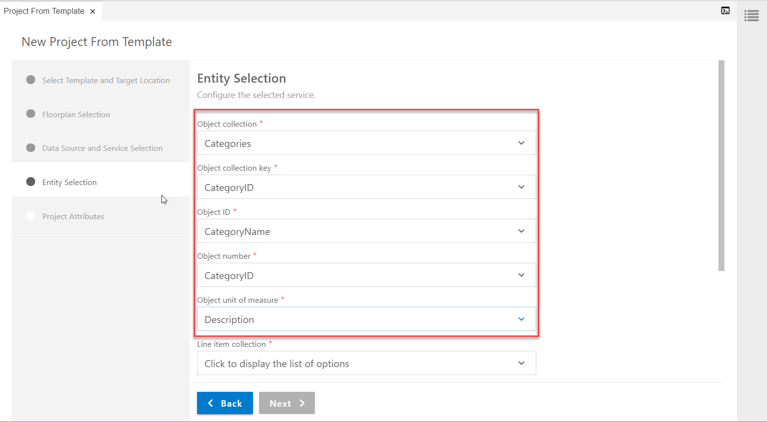
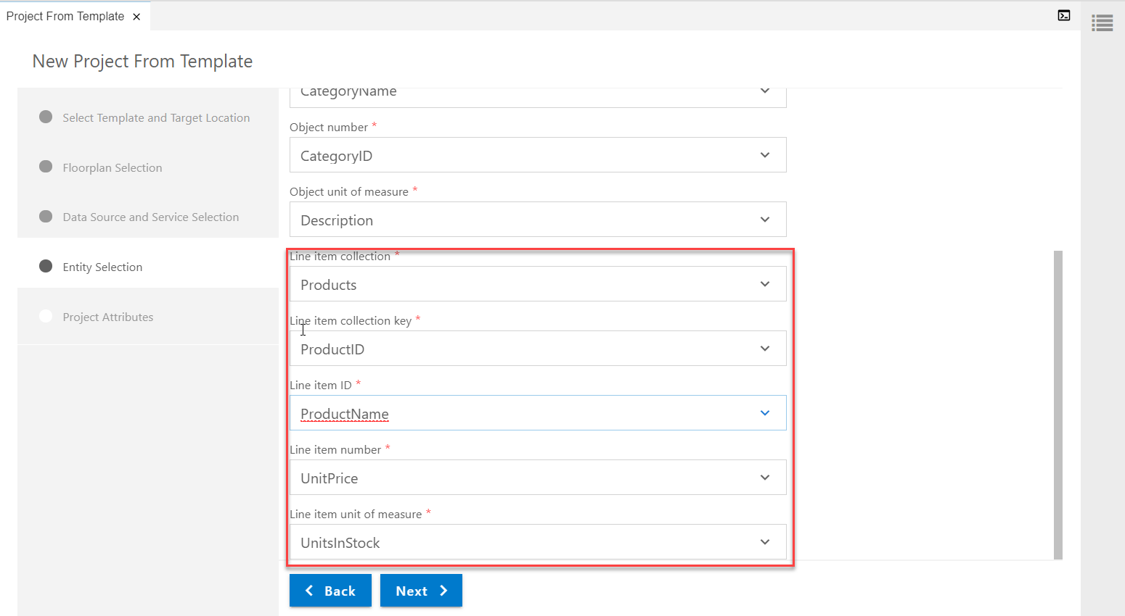
Consuming Northwind OData service
Step3: Entity Selection
3.1 Object Selection(to be viewed in Master Page)
3.2 Line Item Selection (to be viewed in Detail page)

Slide 11
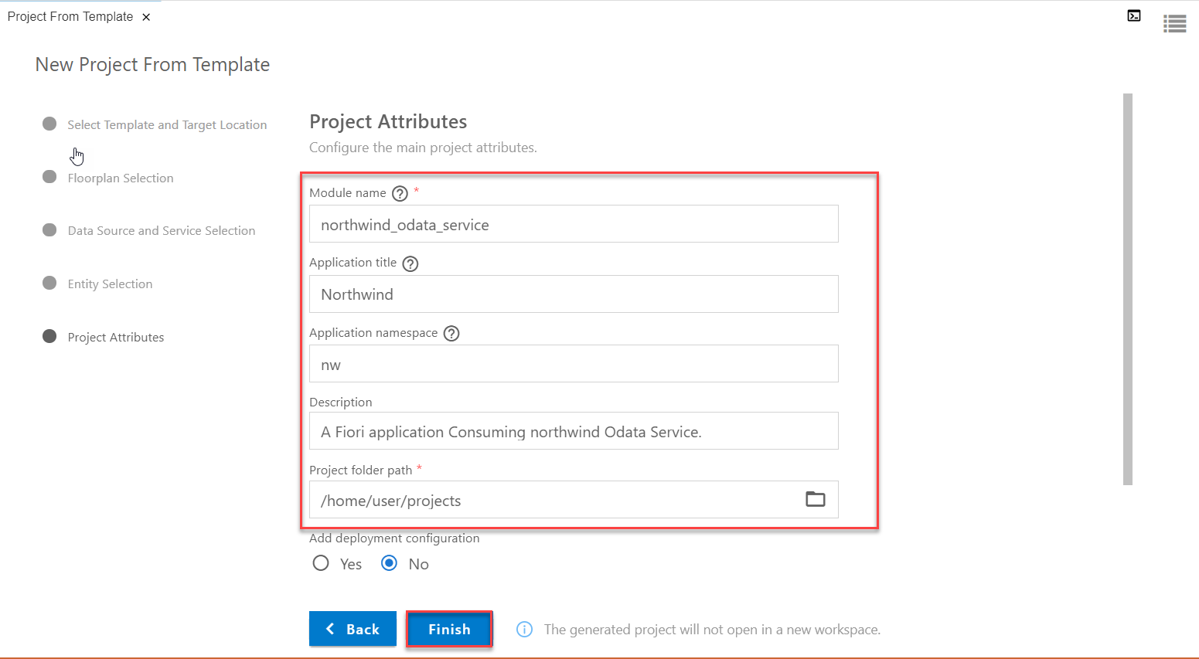
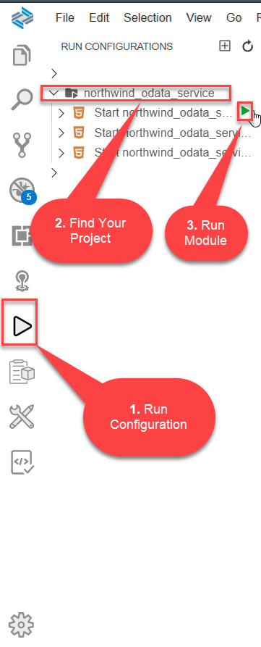
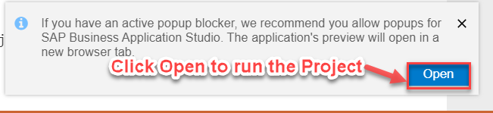
Consuming Northwind OData service
Step4: Finalizing the Project
Step5: Run the project from Run Configuration

Slide 12
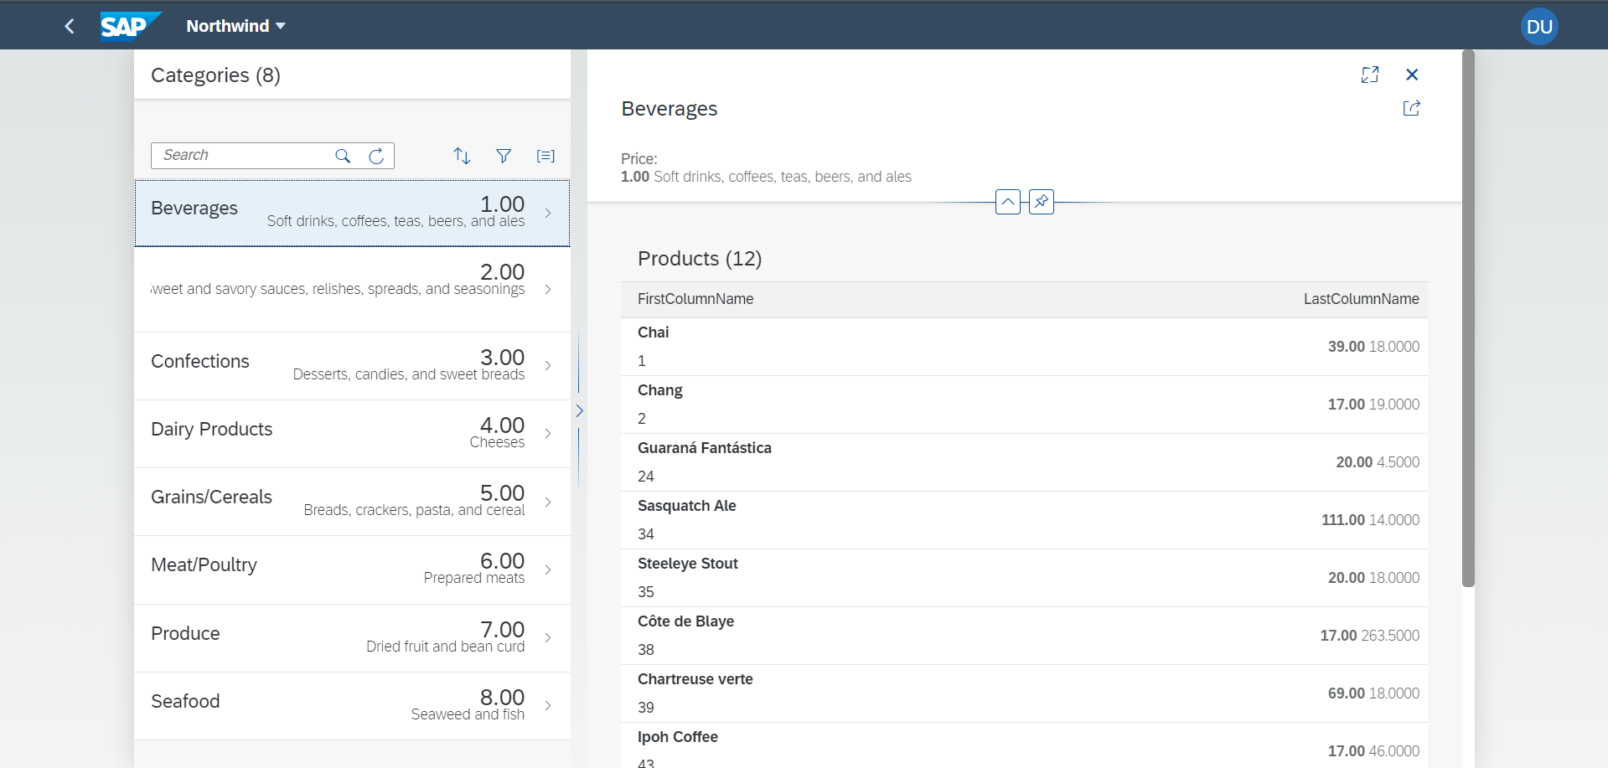
Consuming Northwind OData service
Final Project With Northwind OData Services (i18n File)

Slide 13

Break

Slide 14
Deployment options
Presentation
Option 1: Fiori Central HUB Deployment
Advantage
Able to use Fiori – adapt innovation
We are able to connect now multiple such backend
Separation of duties
More security
Upgrade free
Disadvantage
Cost
Confusion
Manage security double
Functionality is distributed
Redundancy
Latency
SAP Netweaver 7.4
Fiori Frontend System – FES
Gateway system
Fiori
SAP_UI
RFC – SM59
SAP ERP(Application Layer)
Existing functionality and data
Backend -- BES
SAP CRM
SAP SRM
Database
Database
Database

Slide 15
Deployment options
Presentation
Option 2: Embedded Deployment
Advantage
Low Cost
Confusion is gone
No need to create RFC – LOCAL
Setup is much easier
Security is at one place
Low latency
Still use this system as a HUB in future
Disadvantage
We must be on SAP Netweaver 7.4
If the system is down, both fiori and classical functionality will not work.
Fiori
SAP_UI
RFC – SM59
SAP ERP(Application Layer)
Existing functionality and data
Database
SAP_UI and SAP_GWFND
https://www.sap.com/documents/2018/02/f0148939-f27c-0010-82c7-eda71af511fa.html

Slide 16
EPM Data Model
Enterprise Procurement Model – Products, Business Partner (Suppliers and Customers), Orders and Order Items.
BAPIs = Function Modules which are reusable and can be called from another systems as well
BAPI_EPM*
BAPI_EPM_PRODUCT_GET_LIST – All the list of products in the system
BAPI_EPM_PRODUCT_GET_DETAIL – details of a single product
BAPI_EPM_PRODUCT_CREATE – create a new product
BAPI_EPM_PRODUCT_UPDATE – update existing product
BAPI_EPM_PRODUCT_DELETE – delete the product
Business partners (BP)
BAPI_EPM_BP_GET_LIST
BAPI_EPM_BP_GET_DETAIL
BAPI_EPM_BP_CREATE
BAPI_EPM_BP_UPDATE
BAPI_EPM_BP_DELETE
CRUD
Create
Read
Update
Delete

Slide 17
TCode
SEGW – Service Builder
/N/IWFND/MAINT_SERVICE – Registration of services
/N/IWFND/ERROR_LOG – Error logs of service calls
/N/IWFND/GW_CLIENT – test services locally within sap system
ABAP SEGW CLASSES
It has the code which provides the metadata
SAP Generated
It has the code which provides the actual data in the output when EntitySet is called
Runtime Artifacts
MPC
(Model provider Class)
DPC
(Data Provider Class)
MPC_EXT (Extension)
Code which developer will write
DPC_EXT (Extension)
All the ABAP Code which works with CRUD implementations

Slide 18
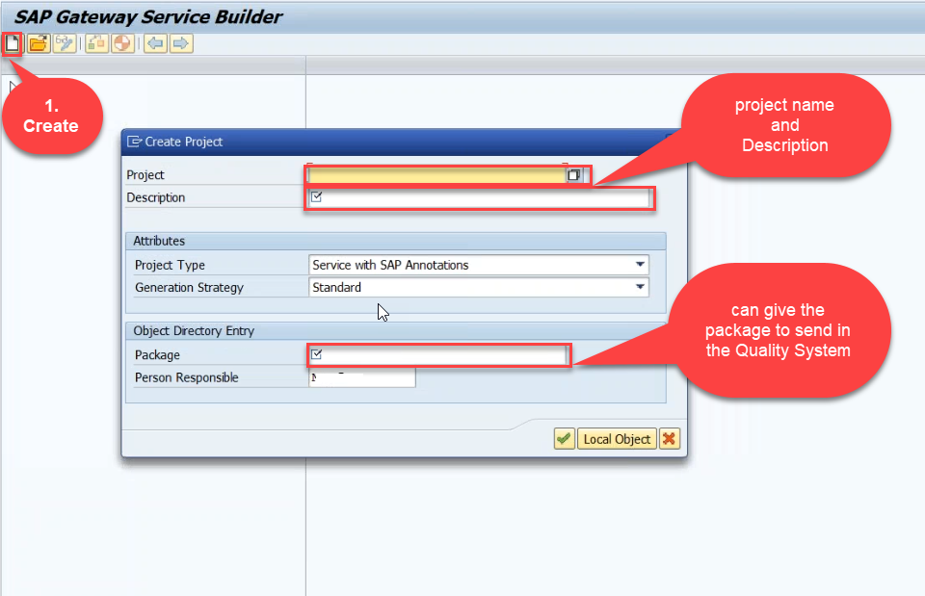
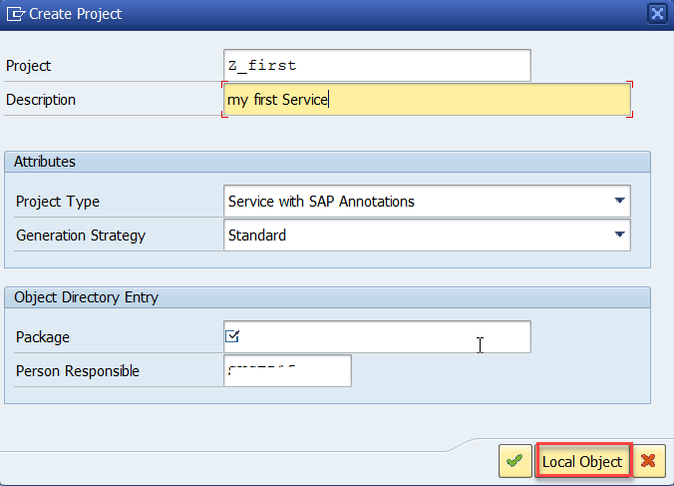
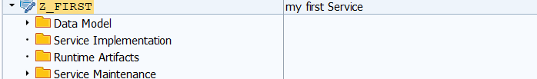
Creating OData Service
Step1: Strat your SAP LOGON, and to Sap Gateway Service Builder(SEGW) and click on Create

Slide 19
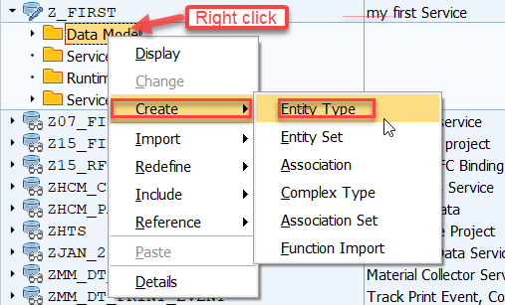
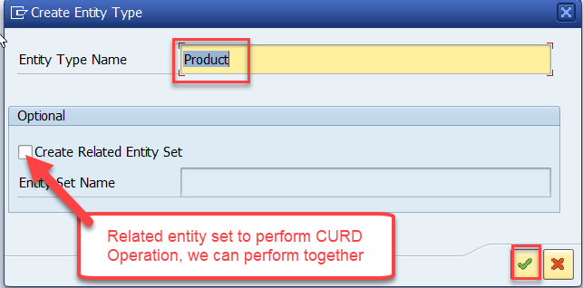
Creating OData Service
Step2: Defining the Data Model (Blue print of data)

Slide 20
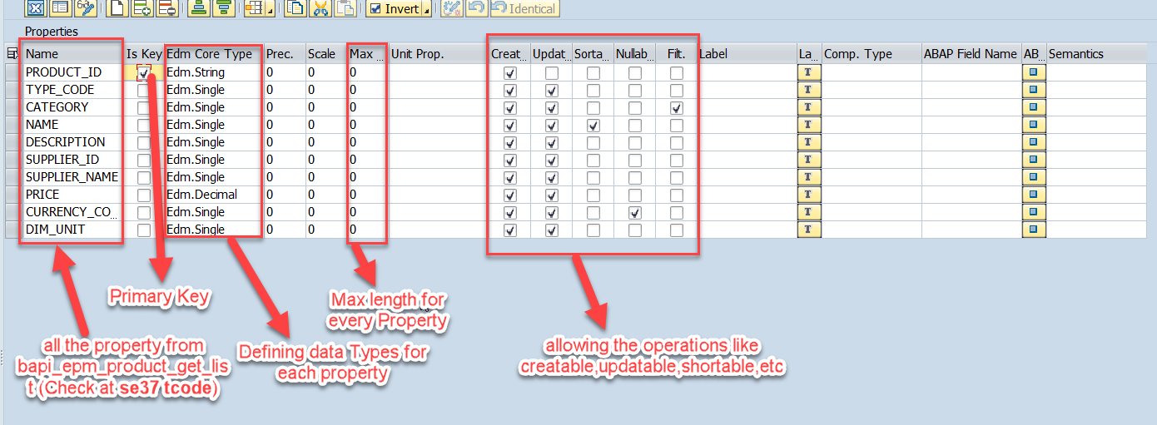
Creating OData Service
Step3: Creating Properties for data model (from bapi_epm_product_get_list (tcode- se37))

Slide 21
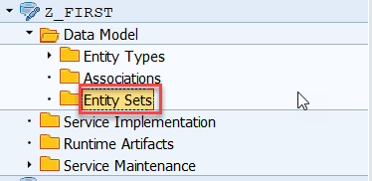
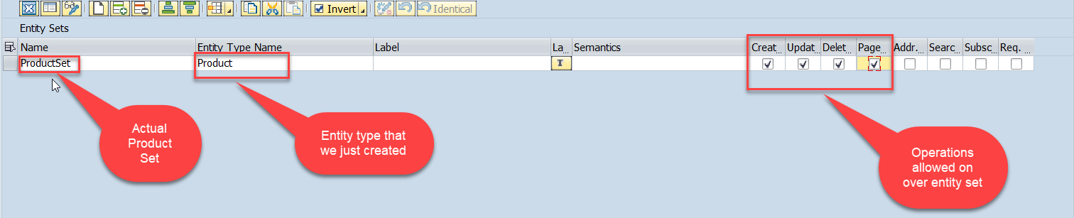
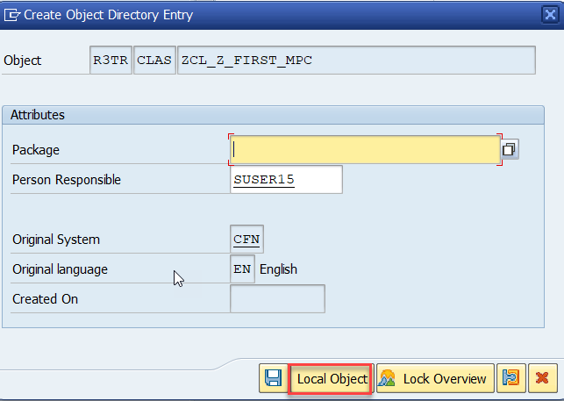
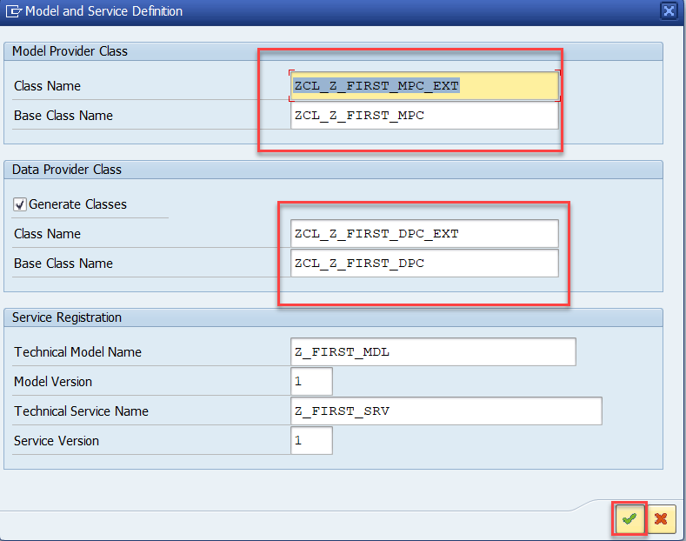
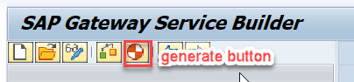
Creating OData Service
Step4: Creating entity set to perform actual CURD operations and service generation

Slide 22
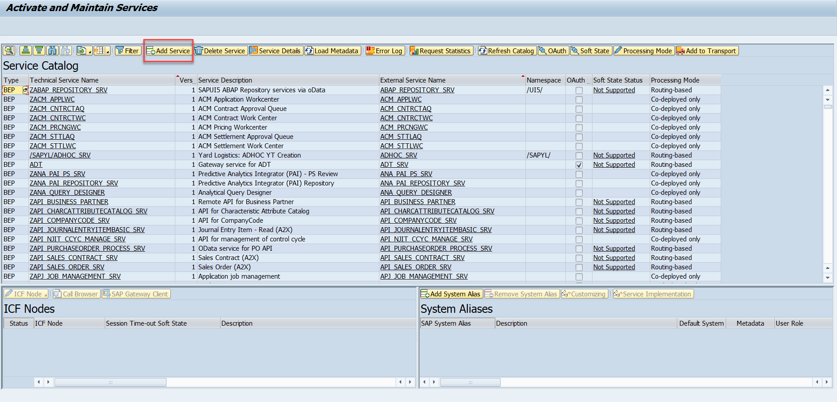
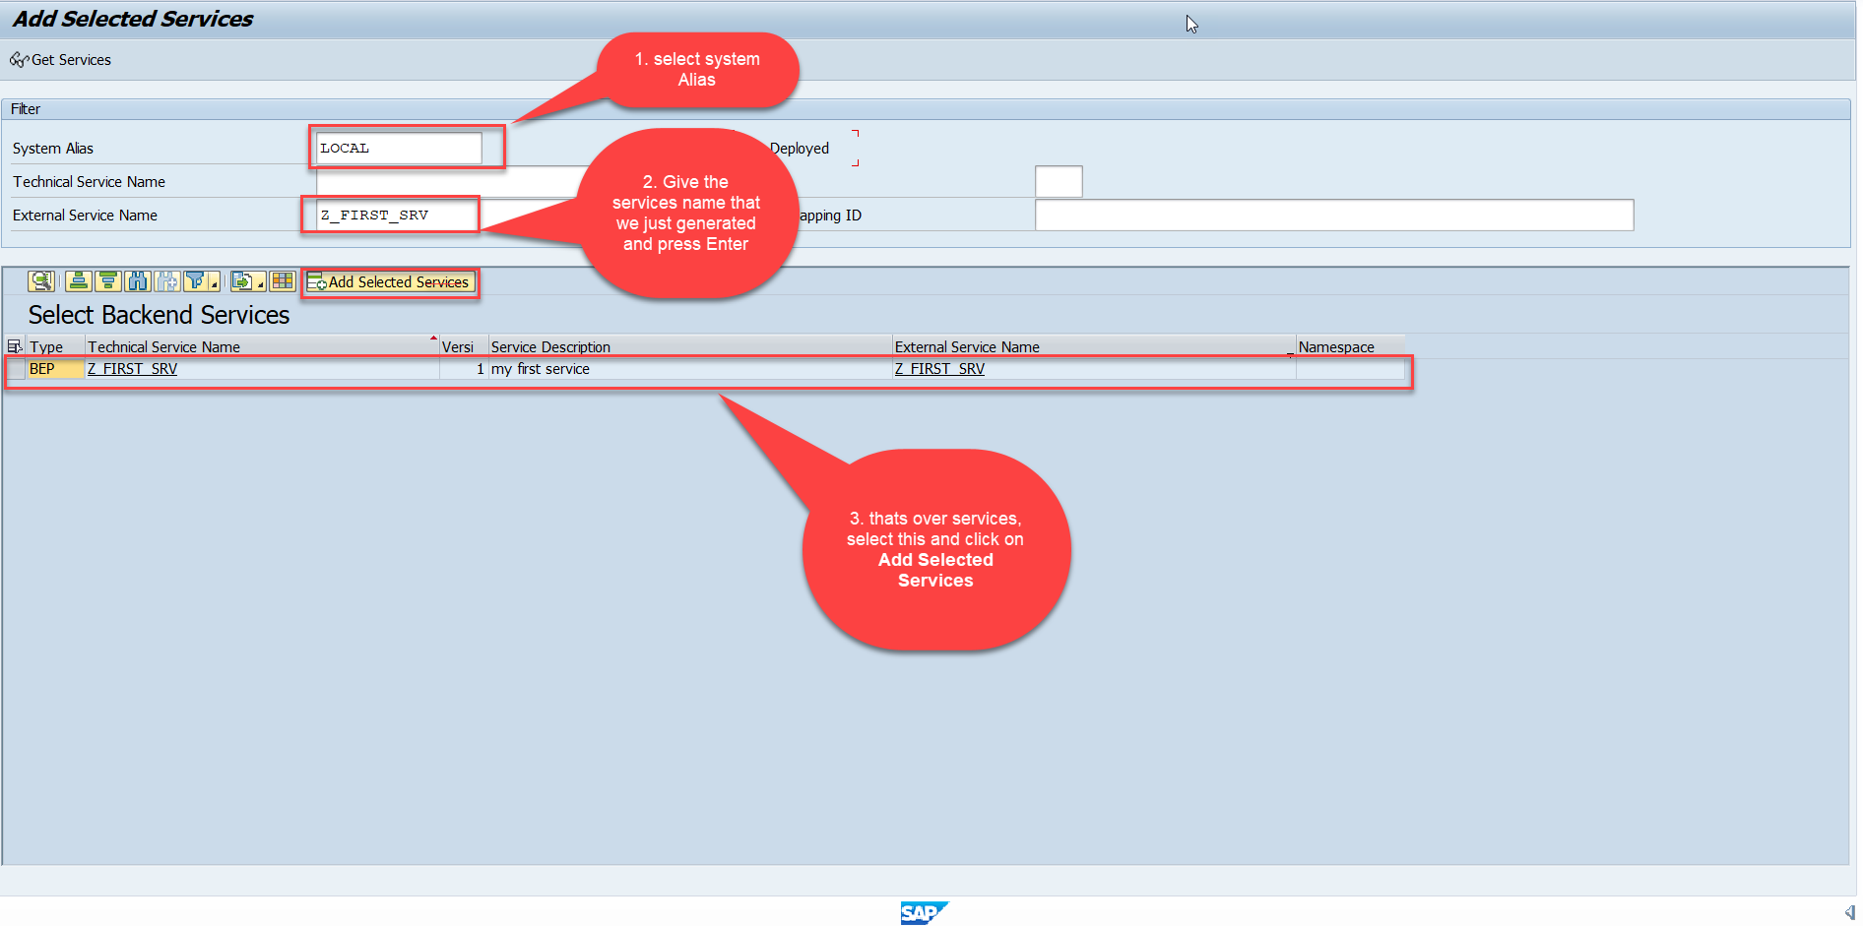
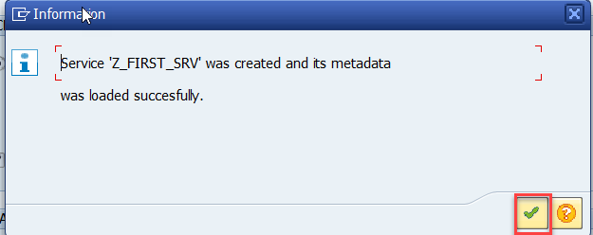
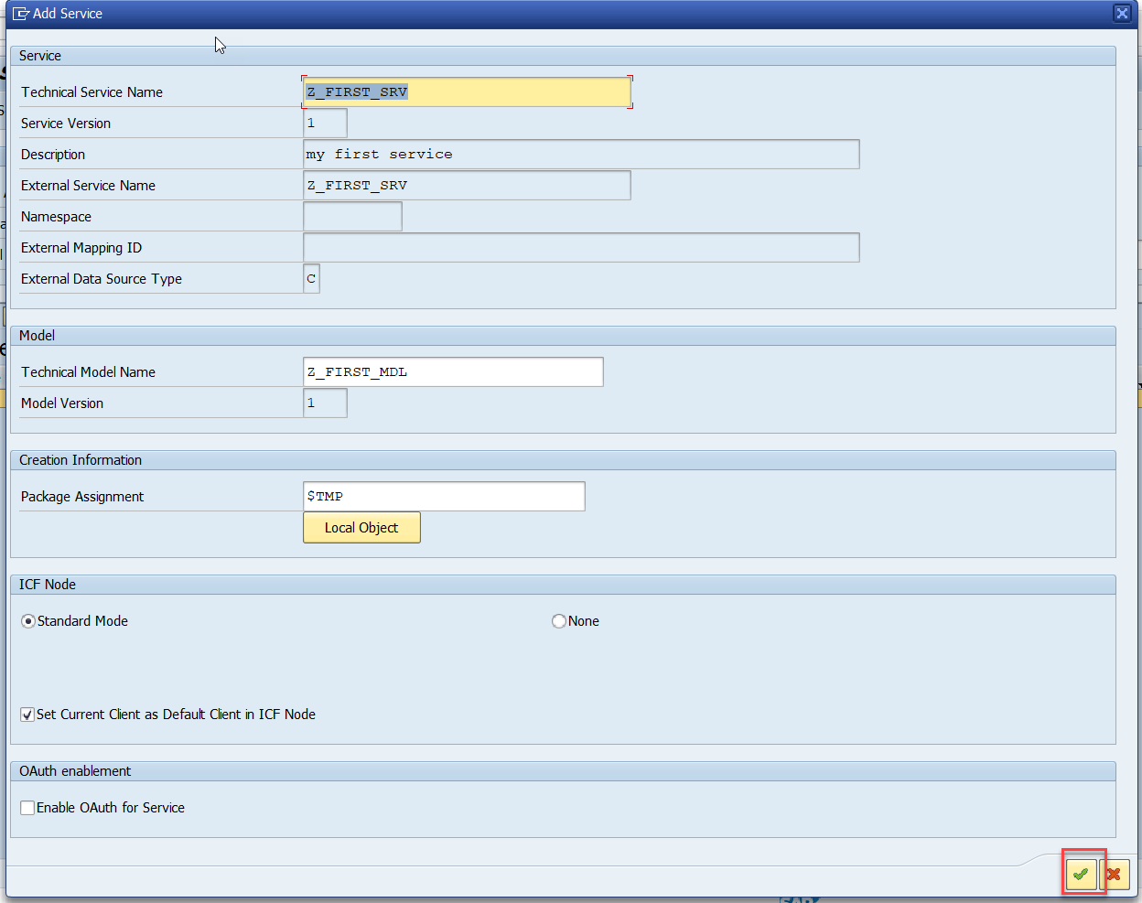
Creating OData Service
Step5: Service Registration (Go to tcode- /iwfnd/maint_service)

Slide 23
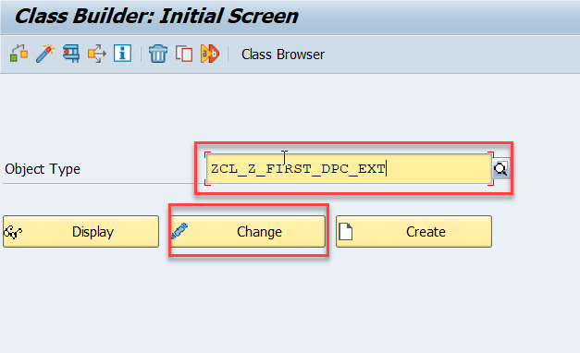
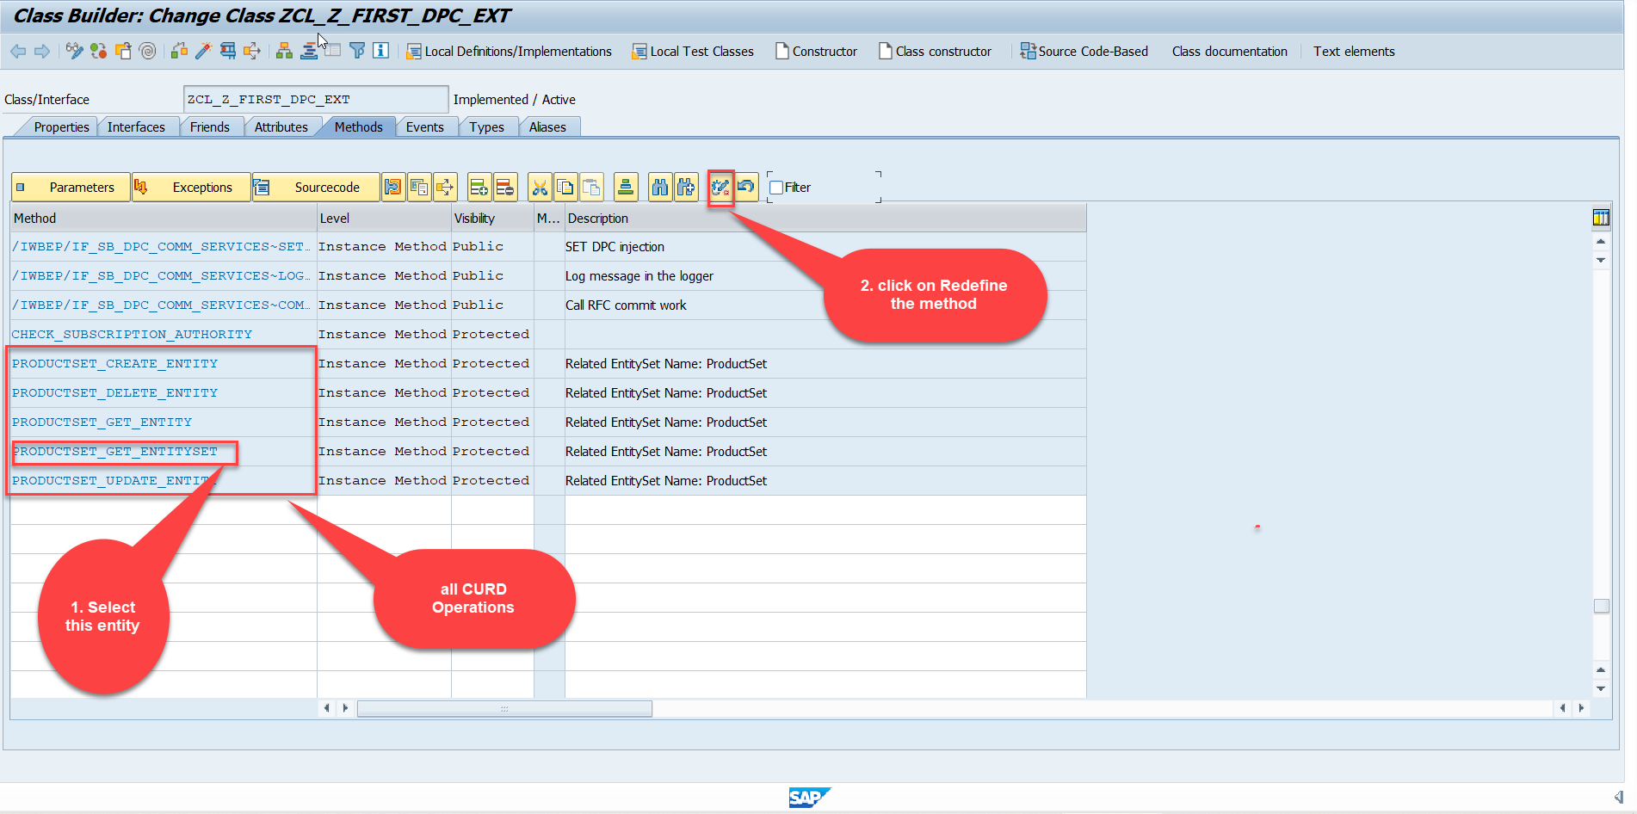
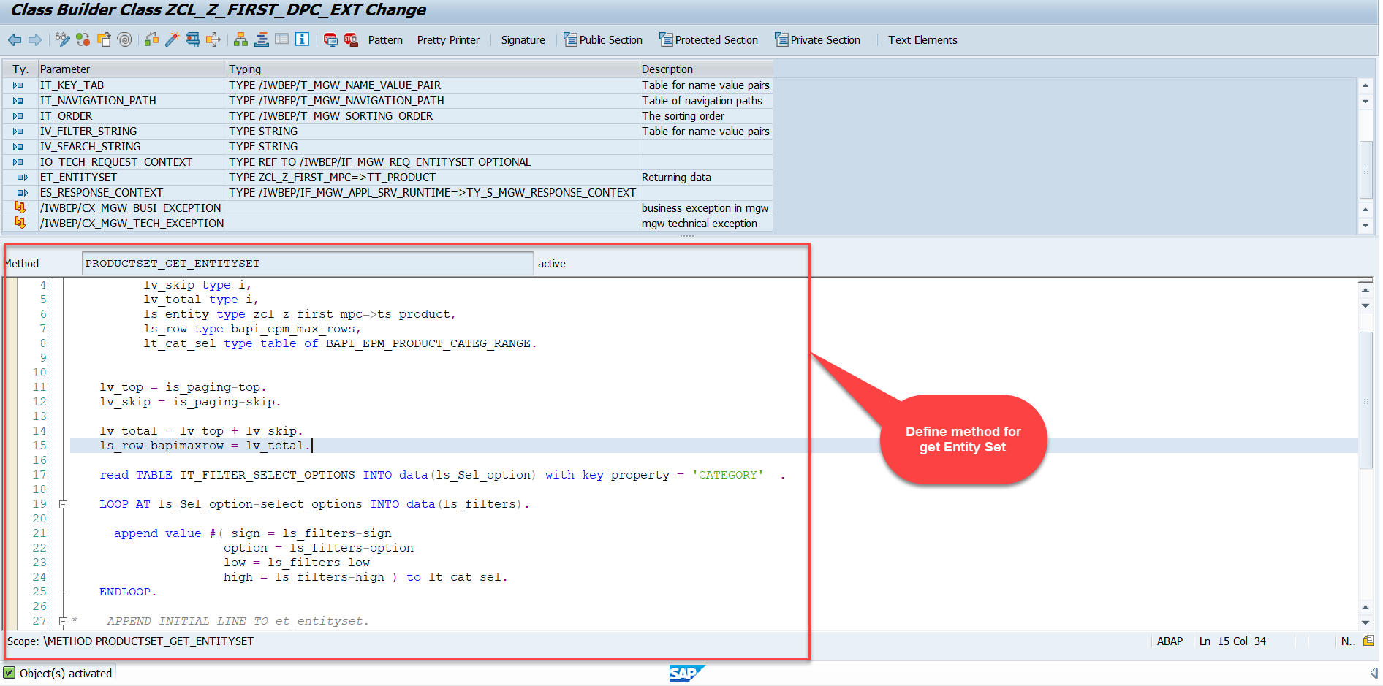
Building GetEntitySet Method
Step1: ProductSet Get Entity method(with filter, top and skip) in DPC Extension (Class Builder tcode- se24)
Note: Click on the image to get Complete code.

Slide 24
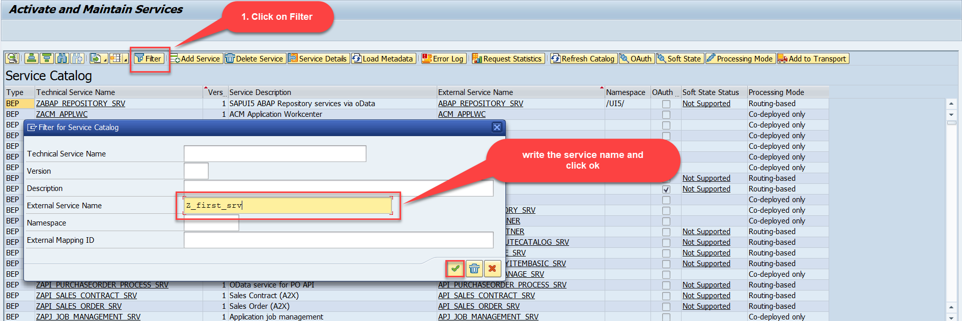
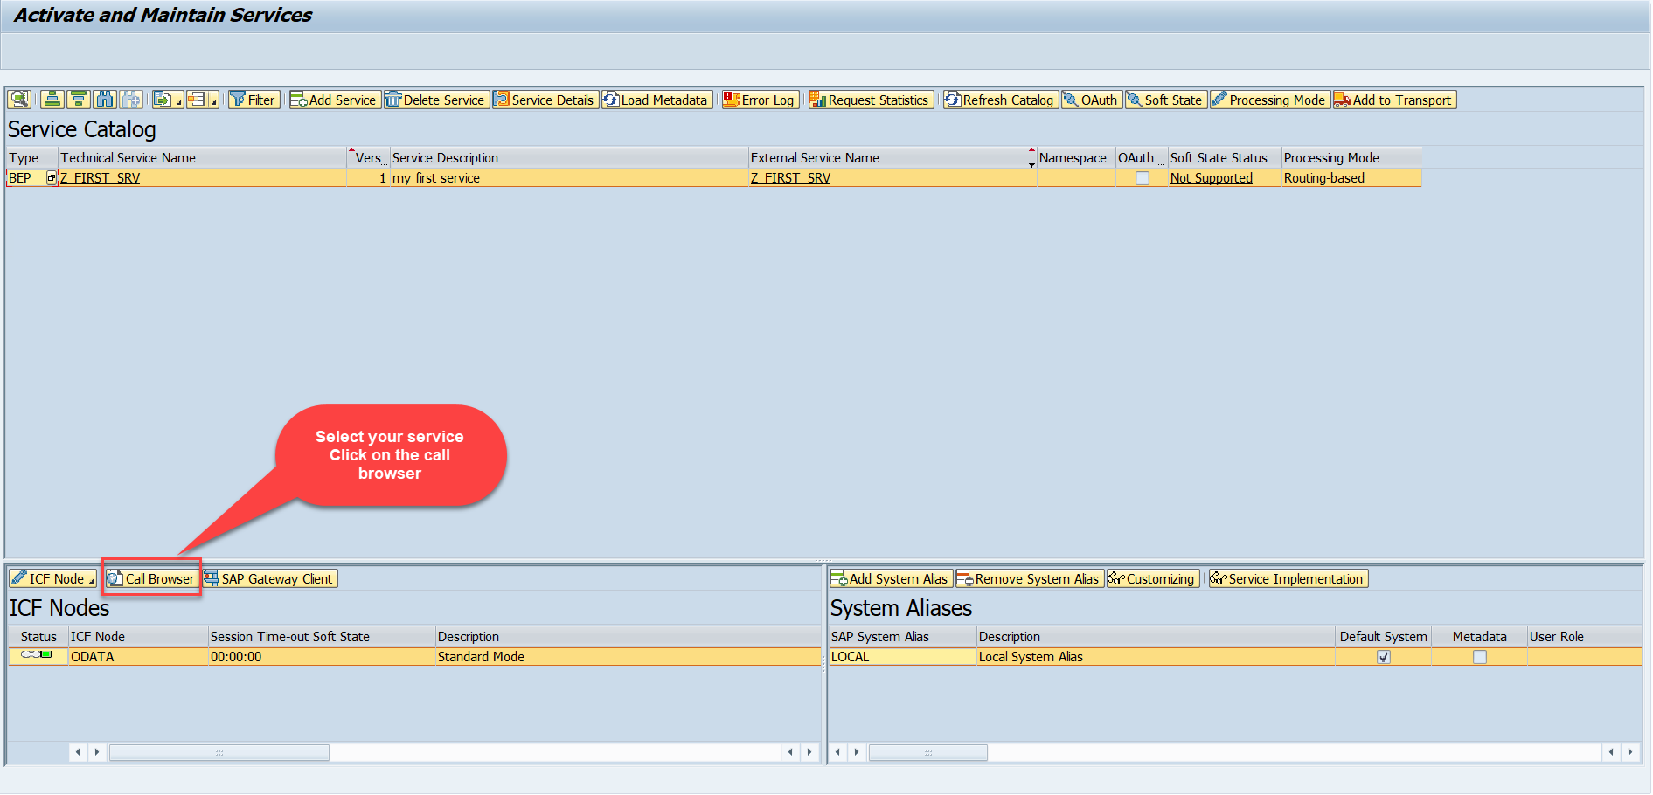
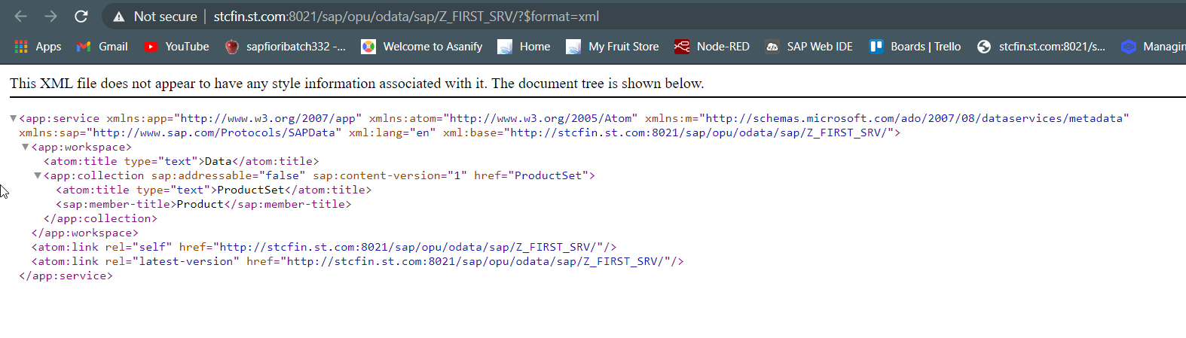
Building GetEntitySet Method
Step2: Call the service to the browser that we just created (go to service maintain (/iwfnd/maint_service))
Service in Browser

Slide 25

End of Day 7

Slide 26

Questions

Slide 27

Anubhav Oberoy

Slide 28


We’re committed to empower you to be
Most Desirable Resource
through powerful training solutions.
We build the workforce of the future.
250+
Corporate Clients
30,000+
Learners Trained
25000+
Learners Placed
FREE WEBINARS
Sign up for free webinars with industry experts every fortnight!
Enroll Now!
Contact us today!
https://anubhavtrainings.com/

Slide 29




More from AnubhavTrainings.com

Slide 30
Title
Content

